Slide 1
Lend ngClub
A Peer-to-Peer Loan Analysis
Team 1
Jonathan Schild
Medhasweta Sen
Brian Gulko
Bharat Premnath
The George Washington University
December 12, 2022

Slide 2


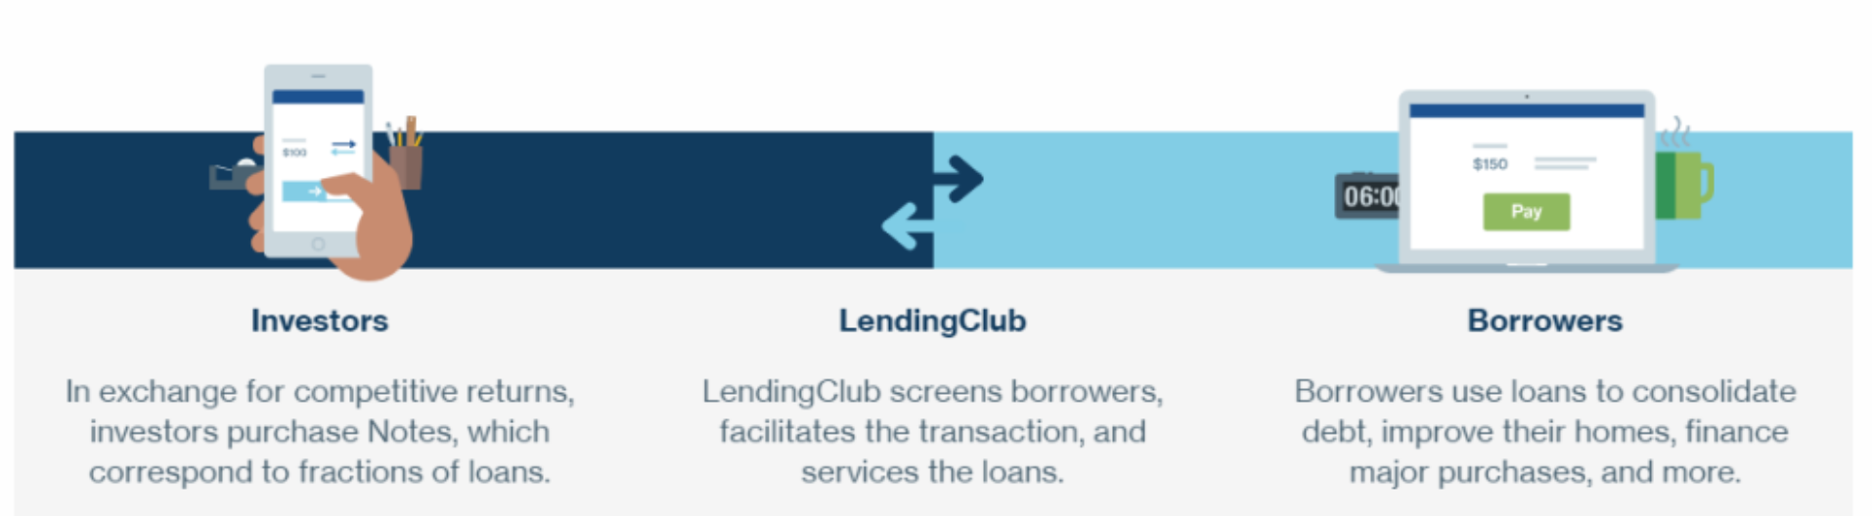
What is LendingClub
Source: https://www.moneysmylife.com/lendingclub-review/
Notes:
Peer-to-peer (P2P) was a phenomenon less than ten years ago, exploding in popularity by offering a break from traditional banking. Individuals flocked to the alternative credit markets as alternative sources of funding and for new opportunities to finance their small business ventures.
Although direct P2P lending has undergone changes over recent years, it remains a viable option for borrowers and investors. We are seeking to understand the factors that might have signalled risky loans or borrowing practices and could be consumed or applied by prospective borrowers, lenders, and/or investors considering participating in direct P2P.

Slide 3
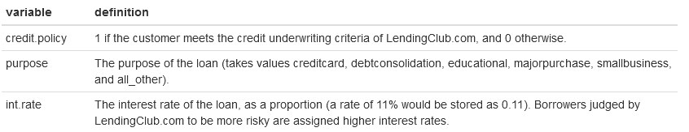
Our Data
9,578 observations
14 variables
11 numeric
2 logical
1 factor with 7 levels
.
.
.
.
.
https://www.kaggle.com/datasets/urstrulyvikas/lending-club-loan-data-analysis
Notes:
Our dataset contains over 9,500 observations of loan data from LendingClub, the largest online platform for direct P2P lending.¹ We believe that the timeframe of 2007 to 2015 provides the most relevant data for prospective individual investors today, particularly because it is unlikely to include a significant number of large institutional lenders.

Slide 4
Added Variables
Natural log of revolving balance (log.revol.bal)
Logical based on if revol.bal is greater than 0 (has.revol.bal)
Logical based on if delinq.2yrs is greater than 0 (has.delinq.2yrs)
Logical based on if pub.rec is greater than 0 (has.pub.rec)
https://www.kaggle.com/datasets/urstrulyvikas/lending-club-loan-data-analysis

Slide 5
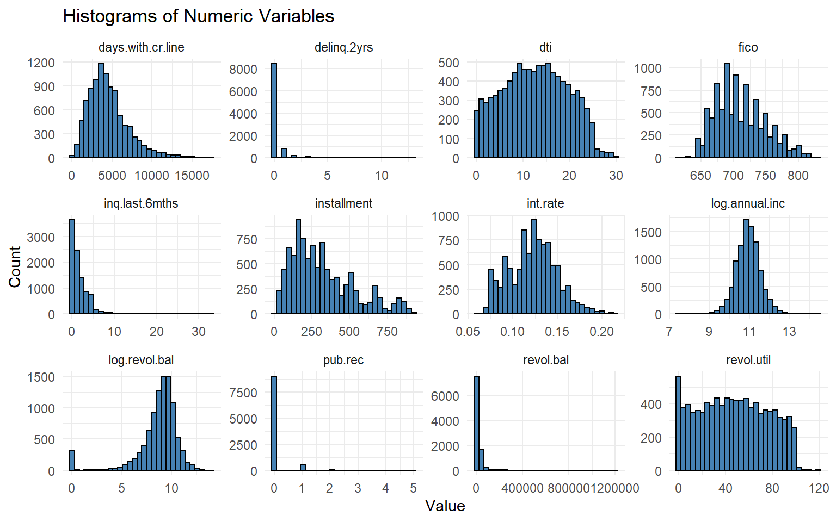
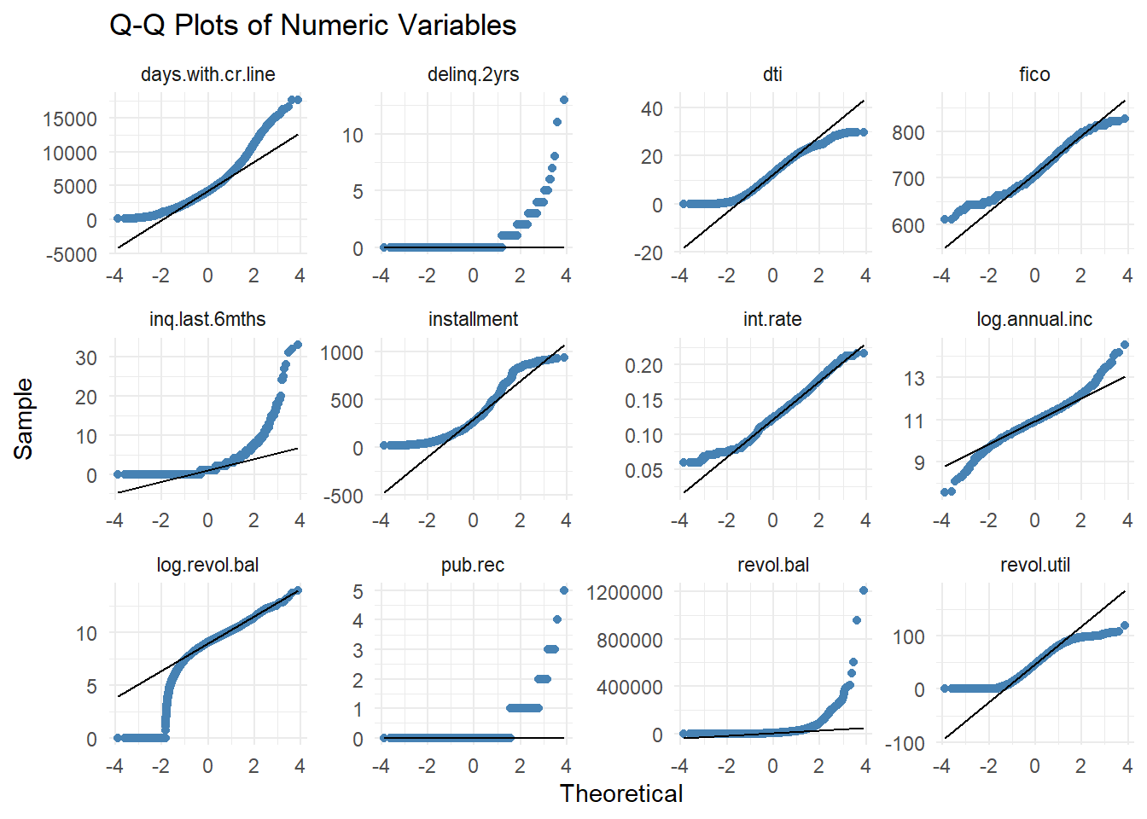
EDA Review

Slide 6
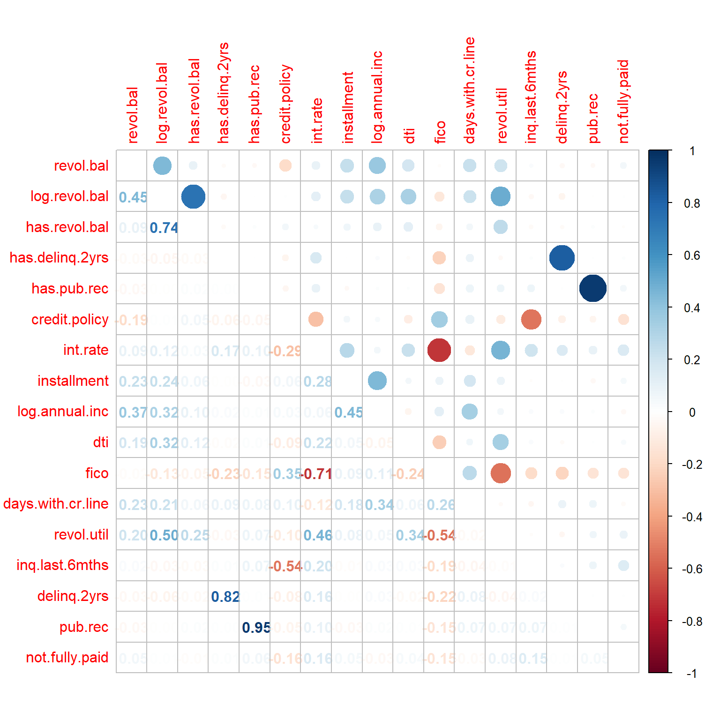
EDA – Correlation Plot

Slide 7
SMART Question & Models Chosen
SMART Questions
What variable or variables, if any, have an impact on if the person meets the credit underwriting criteria?
What variable or variables, if any, have an impact on if the person fully repays the loan?
Do borrowers who meet the credit underwriting criteria have a lower chance of not fully repaying the loan? If so, how big is the difference?
Models
4 Simple Linear Regressions
1 Multiple Regression
2 Logistic Regressions
1 or 2 Classification Trees

Slide 8
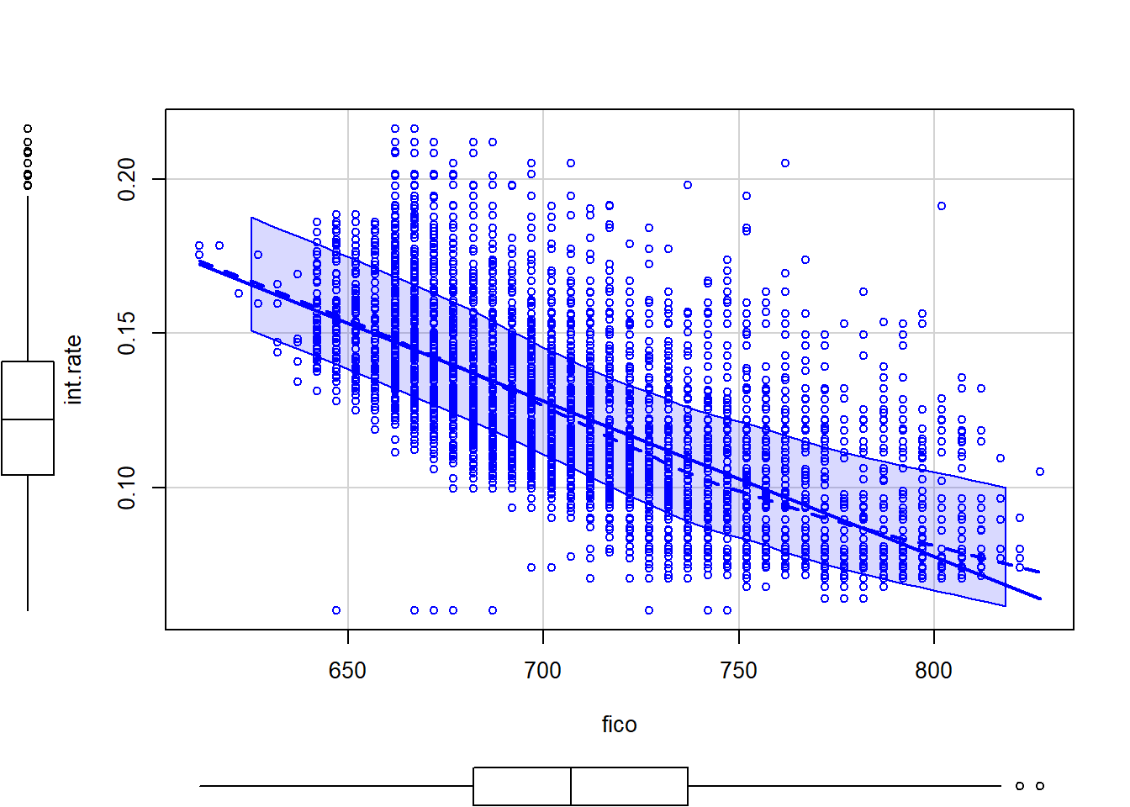
Simple Linear Regression – 1 of 5
R² = 0.51
Pr < 2e-16

Slide 9
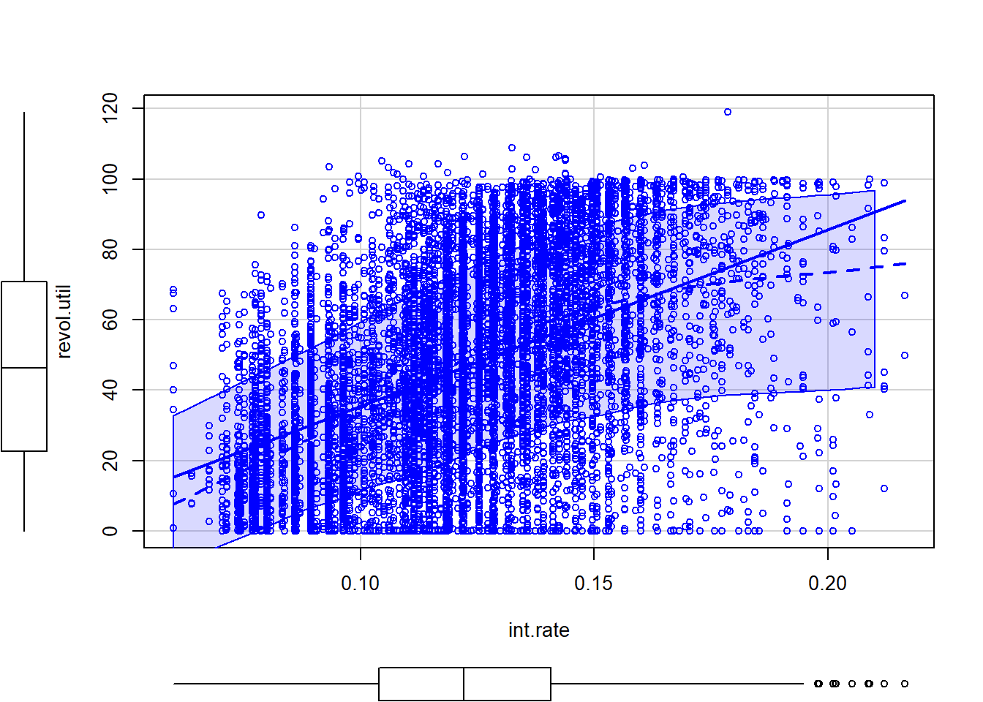
Simple Linear Regression – 2 of 5
R² = 0.22
Pr < 2e-16

Slide 10
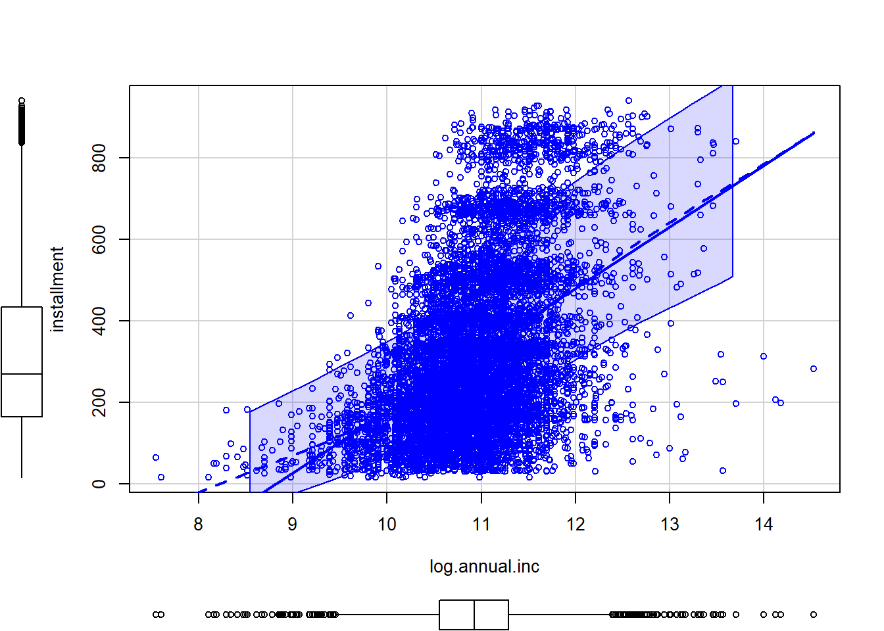
Simple Linear Regression – 3 of 5
R² = 0.20
Pr < 2e-16

Slide 11
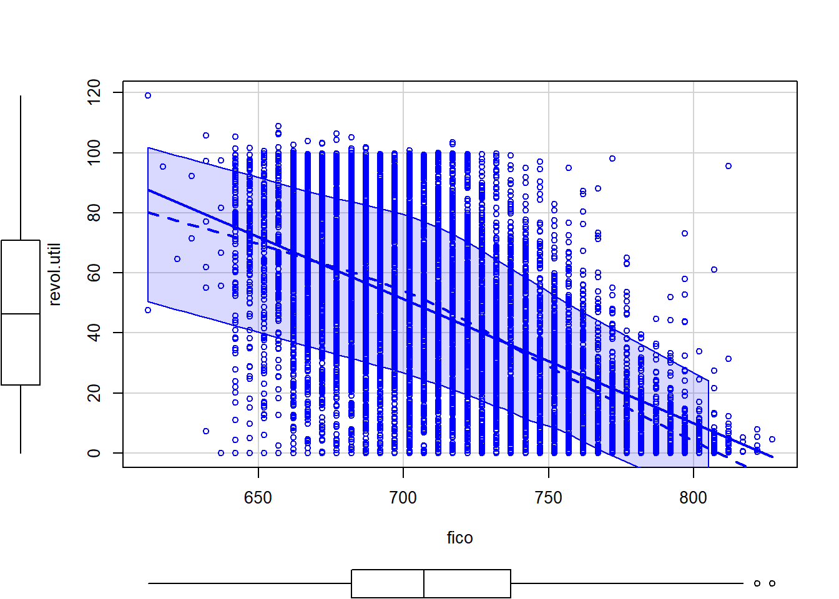
Simple Linear Regression – 4 of 5
R² = 0.29
Pr < 2e-16

Slide 12
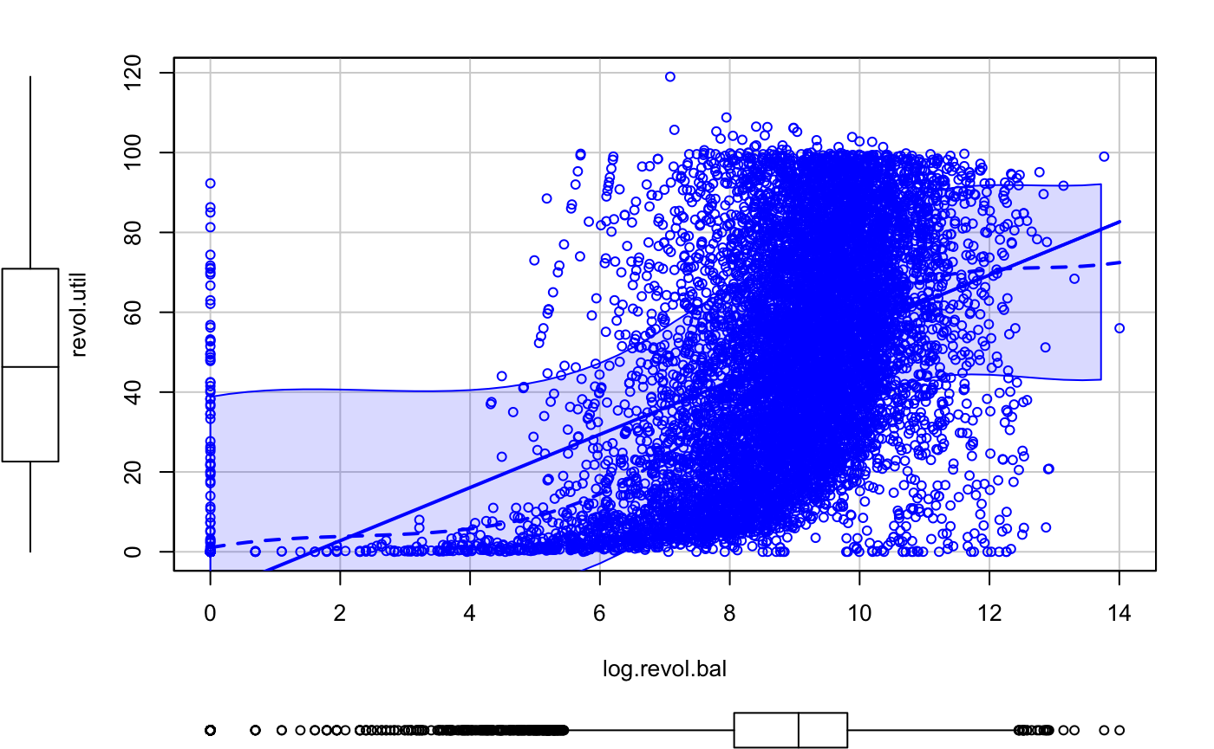
Simple Linear Regression – 5 of 5
R² = 0.25
Pr < 2e-16

Slide 13
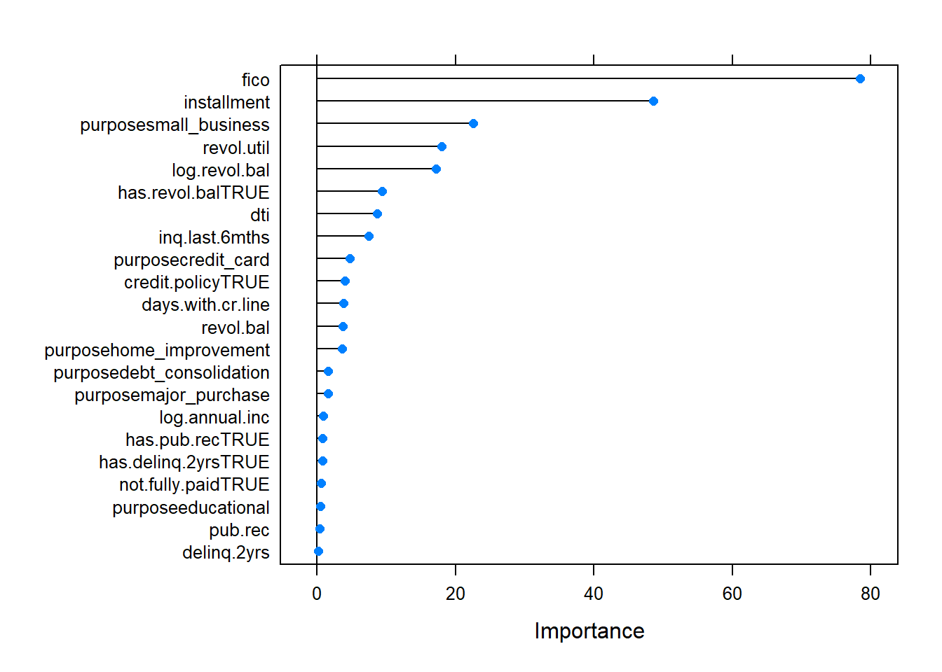
Multiple Linear Regression – Int Rate

Slide 14
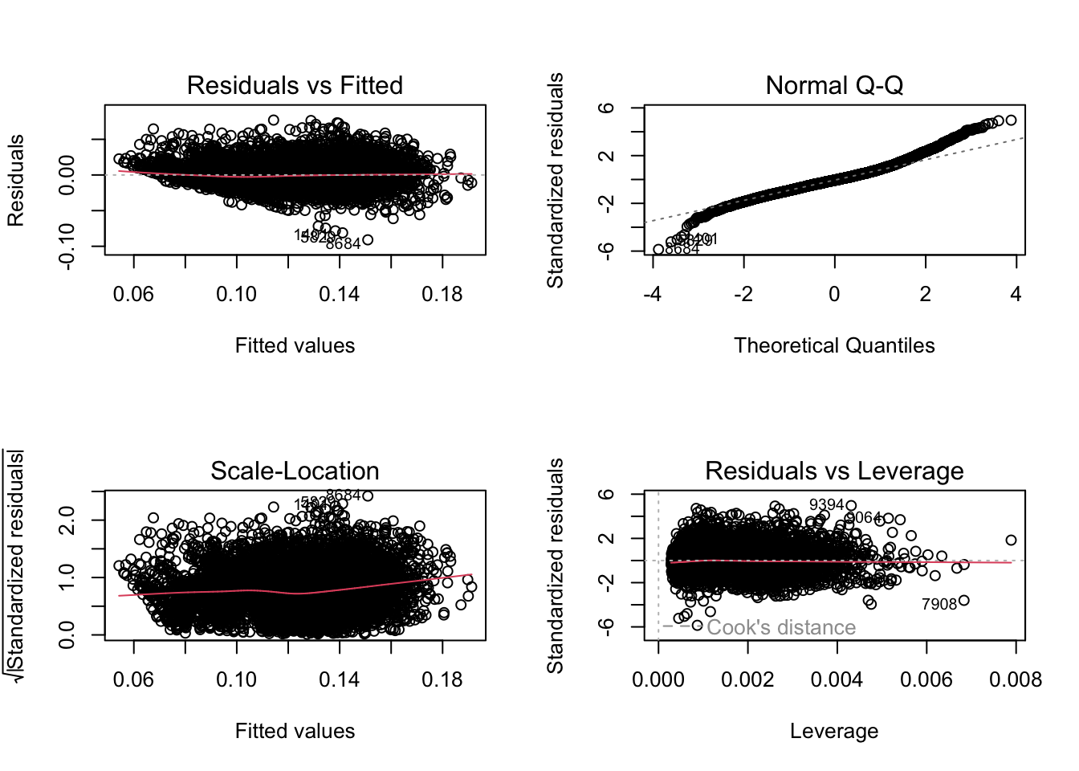
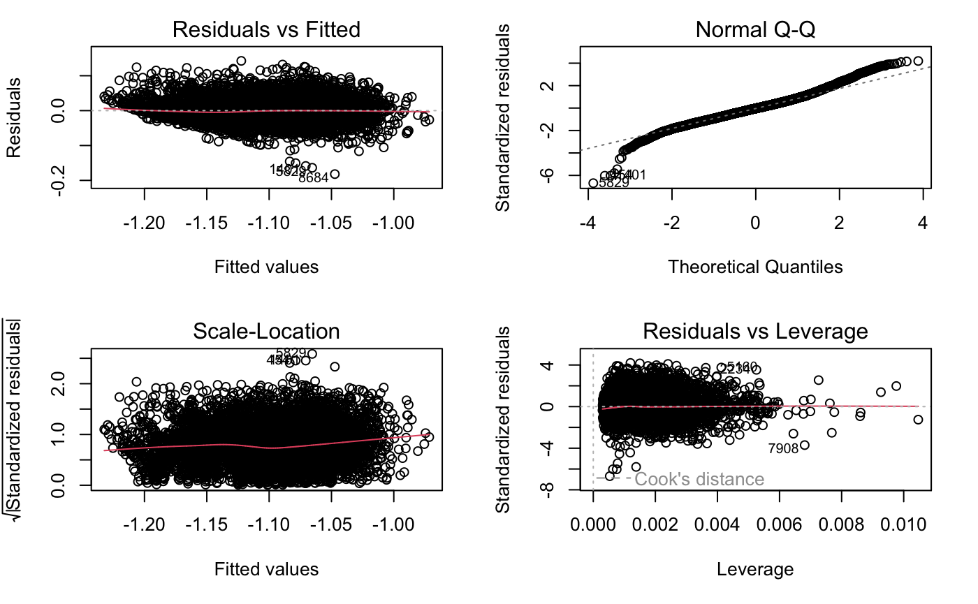
Multiple Linear Regression – Int Rate

Slide 15
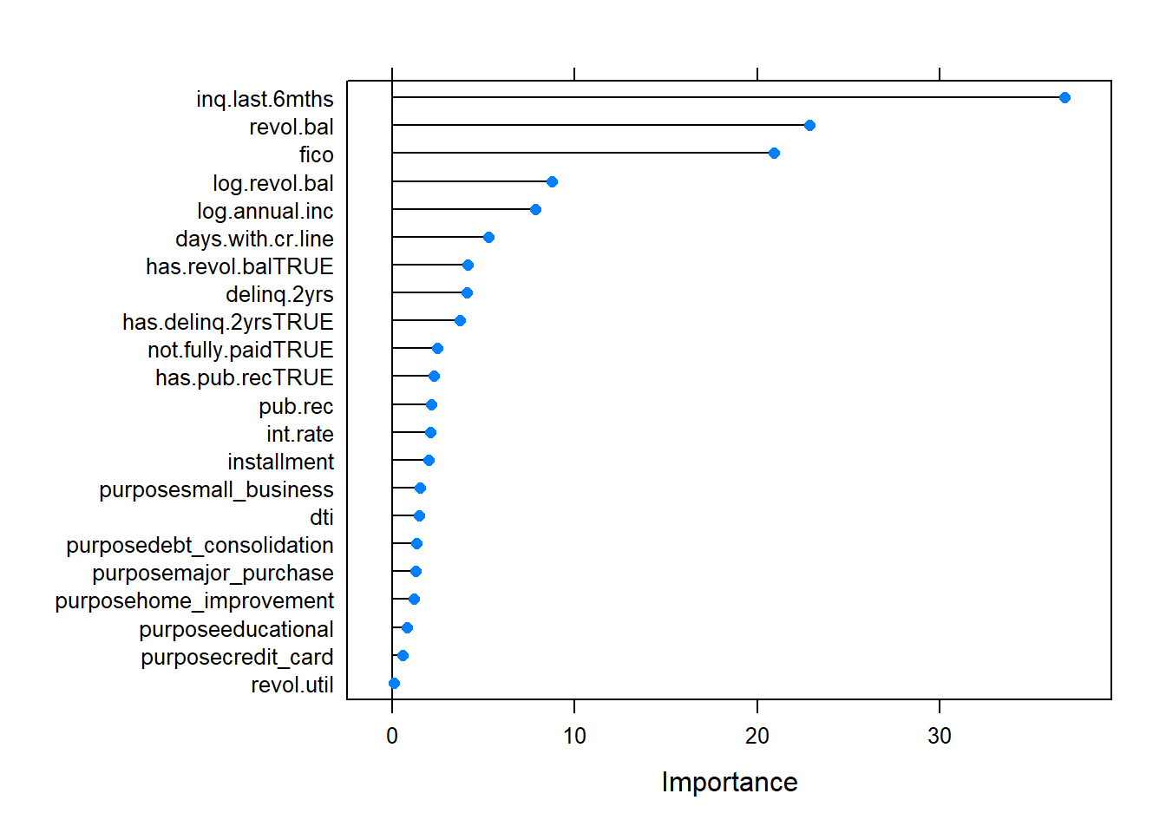
Logistic Regression – Credit Policy (fix)

Slide 16
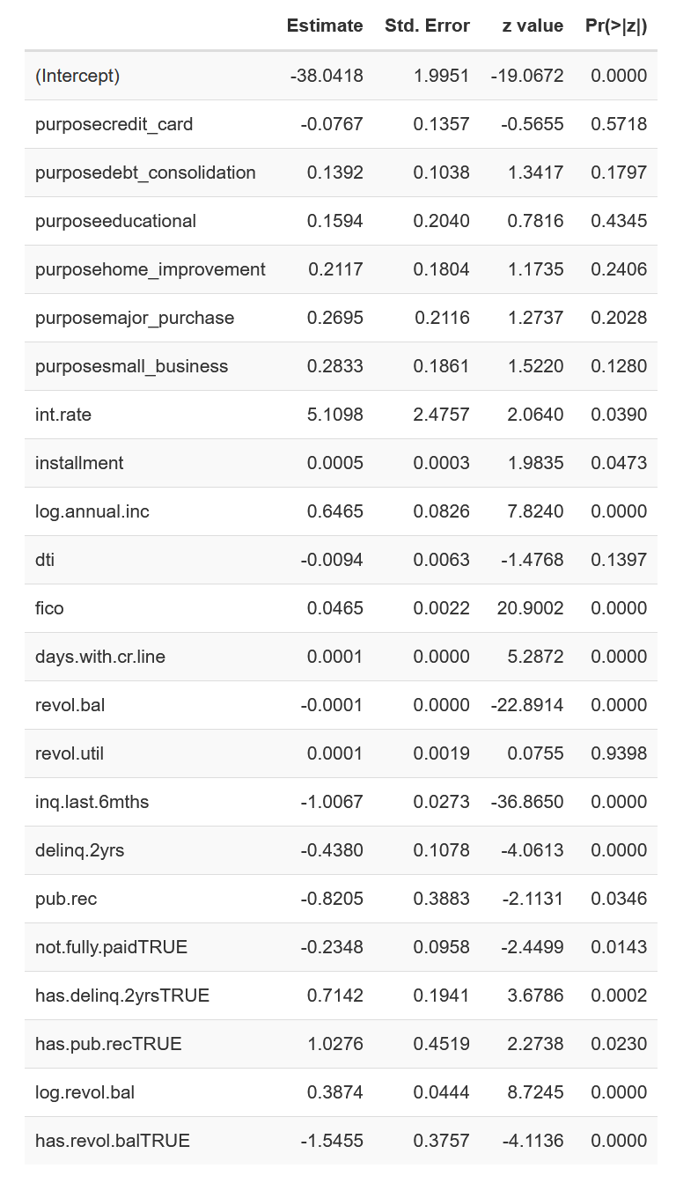
Logistic Regression – Credit Policy (fix)

Slide 17
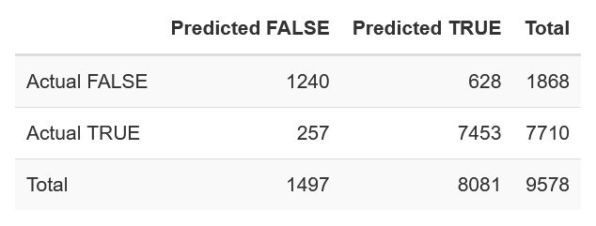
Logistic Regression – Credit Policy (fix)

Slide 18
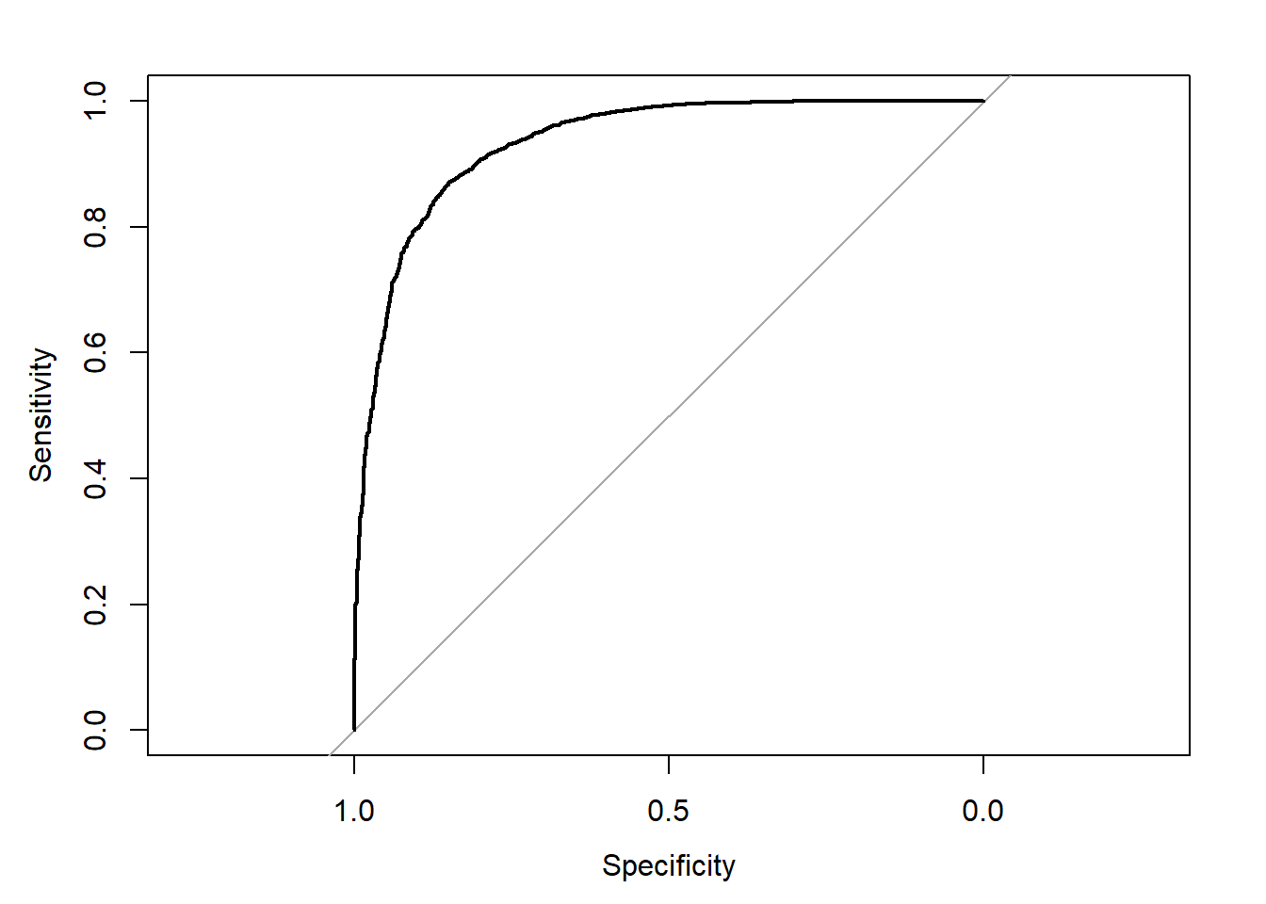
Logistic Regression – Credit Policy (fix)

Slide 19
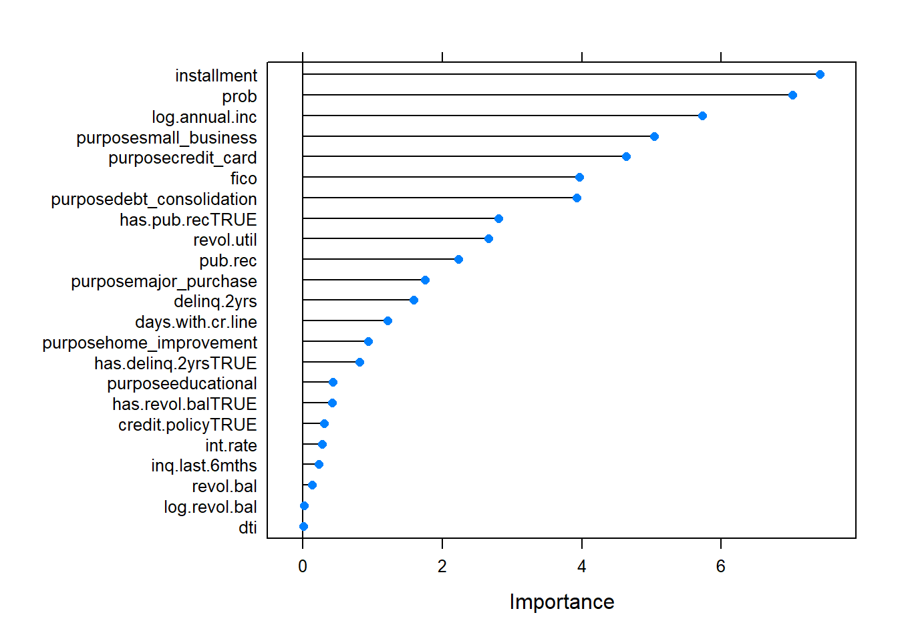
Logistic Regression – Not Fully Paid

Slide 20
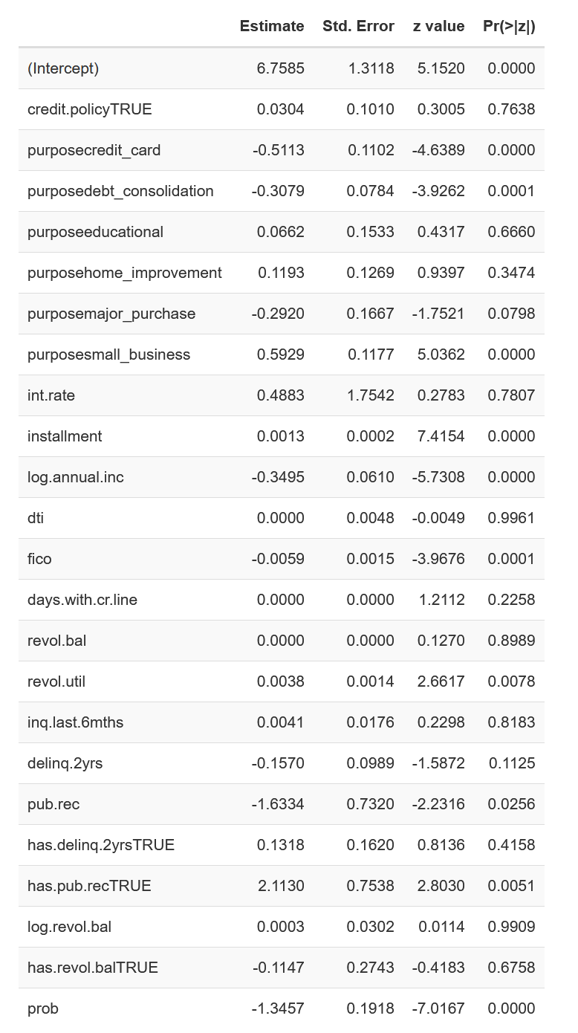
Logistic Regression – Not Fully Paid

Slide 21
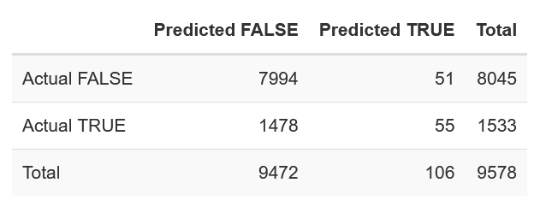
Logistic Regression – Not Fully Paid

Slide 22
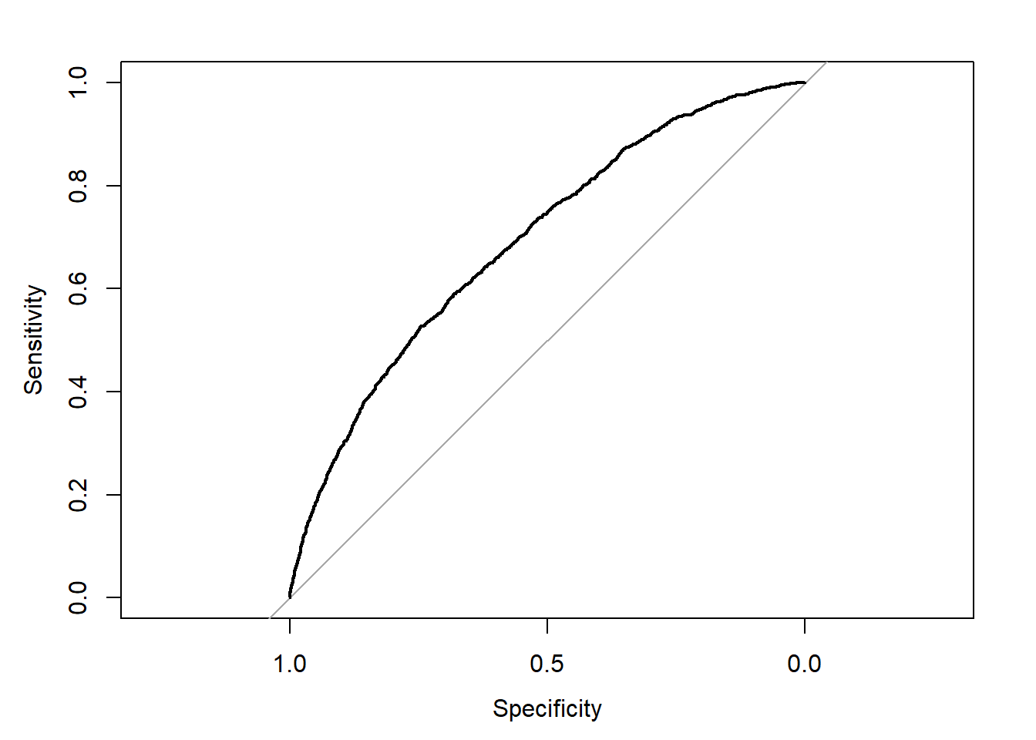
Logistic Regression – Not Fully Paid

Slide 23
Lasso Regression

Slide 24
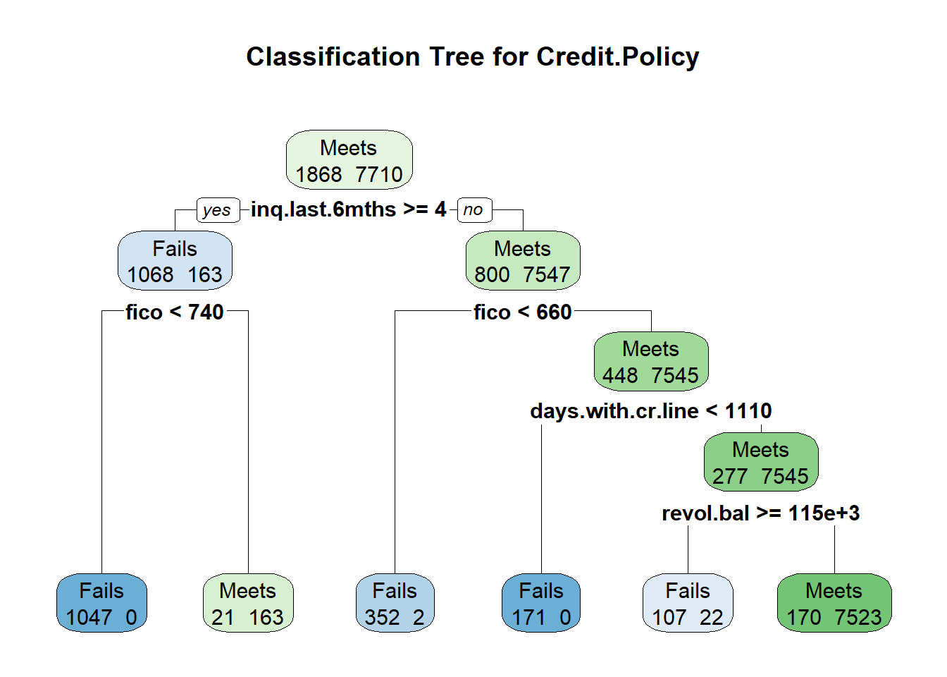
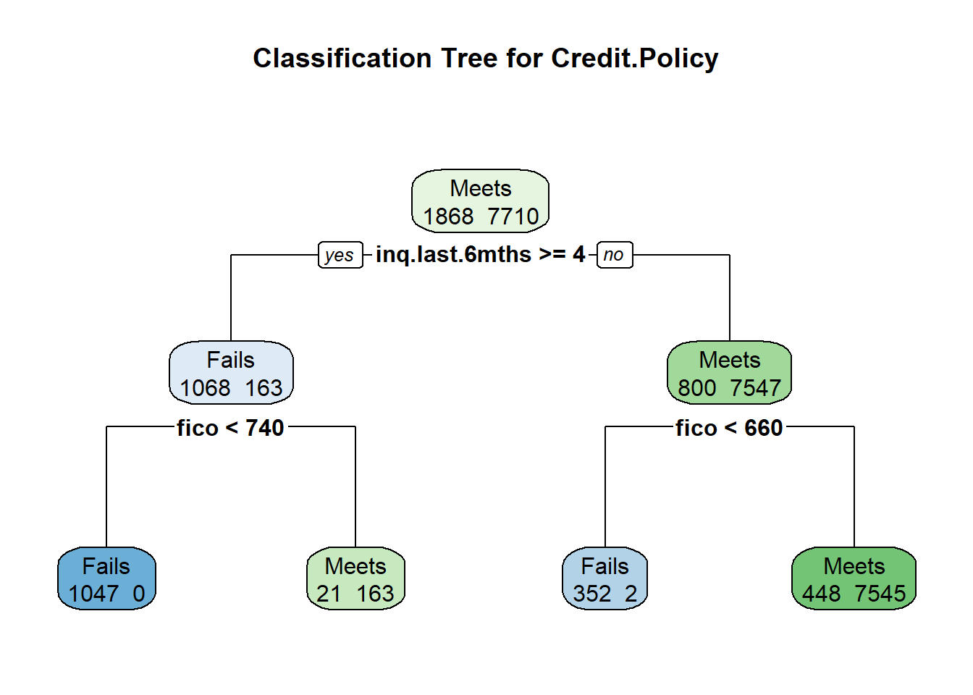
Classification Tree – Credit Policy
Tree
Four variables
5 splits
Confusion Matrix
Sensitivity: 0.899
Specificity: 0.997
AUC: 0.953
Kappa: 0.926
Predictions vs Actual
1677/1868 true negatives (Fails)
7686/7710 true positives (Meets)
Sensitivity (true positive rate) refers to the probability of a positive test, conditioned on truly being positive.
Specificity (true negative rate) refers to the probability of a negative test, conditioned on truly being negative.
The kappa coefficient measures the agreement between classification and truth values. A kappa value of 1 represents perfect agreement, while a value of 0 represents no agreement.
Notes:
Explain tree:
Confusion Matrix:
The sensitivity value indicates the test can fairly reliably detect loans that meet the credit policy
The specificity value indicates the test can fairly reliably detect loans that fail to meet the credit policy
These high values, as well as the high area under the ROC curve value, indicate a favorable ROC curve and a favorable model. The very high kappa value of .926 suggests there is a high degree of agreement between the predicted values and the actual values.
Sensitivity (true positive rate) refers to the probability of a positive test, conditioned on truly being positive.
Specificity (true negative rate) refers to the probability of a negative test, conditioned on truly being negative.

Slide 25
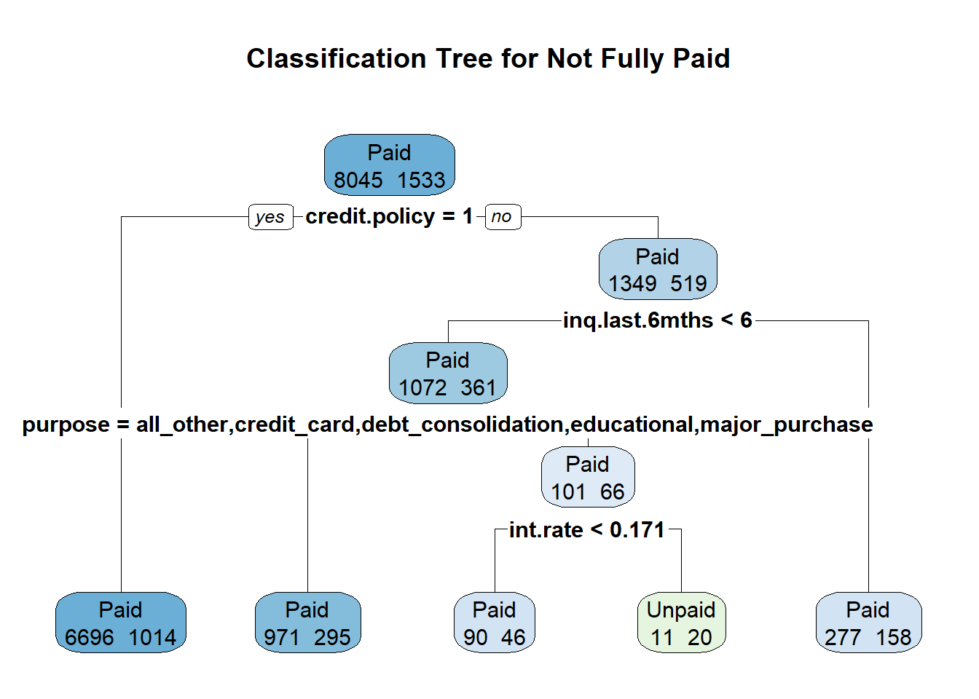
Classification Tree – Not Fully Paid
Tree
CP forced to .001
Four variables
4 splits
Confusion Matrix
Sensitivity: 0.999
Specificity: 0.013
AUC: 0.59
Kappa: 0.019
Predictions vs Actual
8034/8045 true negatives (Paid)
20/1533 true positives (Unpaid)
The kappa coefficient measures the agreement between classification and truth values. A kappa value of 1 represents perfect agreement, while a value of 0 represents no agreement.
Notes:
Explain tree:
Our initial classification tree revealed in no chosen variables and only the single root node, a kappa value of 0, and a ROC curve that fit directly on the random classifier line. We interpreted this as a strong indicator that a classification tree would not be useful for the `not.fully.paid` variable. To confirm this indication, we overrode the default complexity parameter in the rPart function and set it from .01 to .001. By reducing that value in R, we reduce the minimum improvement threshold required at each node for the tree to be built; i.e., essentially lowering the restrictions on how and when the tree is constructed.
This led to the classification tree using the variables `credit.policy`, `inq.last.6mths`, `int.rate`, and `purpose` in building the tree. Looking at it though, and with our initially suspicion regarding the usefulness of the tree, we can see that it is not very informative. We can see that the majority of loans that met the credit.policy, paid the loan, which we would generally expect. We can also see that that those loans that did not meet the credit policy, had higher a number of inquiries in the last 6 months, and higher interest rates, would probably more susceptible of going Unpaid; this is also what we would generally expect to see.
IF ASKED: we do not consider the distinction between loan purpose to be meaningful because of the number of Unpaid values among other leaf nodes and their proportion to the Paid values.
Confusion Matrix:
Low area under ROC curve indicates the model has little to no ability to discriminate between Paid and Unpaid classes.
Based on the extremely low Kappa statistic of .019, there is nearly no agreement between the predictive model and the actual data.

Slide 26
Model Application
Actual Credit Policy
Credit Policy | Percent Not Fully Paid
Fails | 27.8%
Meets | 13.2%
Decision Tree Predicted Credit Policy
Credit Policy | Percent Not Fully Paid
Fails | ???%
Meets | ???%
Logistic Regression Predicted Credit Policy
Credit Policy | Percent Not Fully Paid
Fails | ???%
Meets | ???%
Notes:
From this we can see that about 13.2% of borrowers who met the credit underwriting criteria did not fully pay, while for the borrowers who did not meet the credit underwriting criteria about 27.8% did not fully pay.
This indicates borrowers who did not meet the credit underwriting criteria were almost twice as likely to be default on their loans than those who did meet the criteria. For comparison, default rates on loans from commercial banks for the same period as our dataset averaged 4.48%, with a maximum default rate of 7.49% default rate towards the end of 2009, according to the St. Louis Federal Reserve Bank.

Slide 27
Questions?

